Slide 1
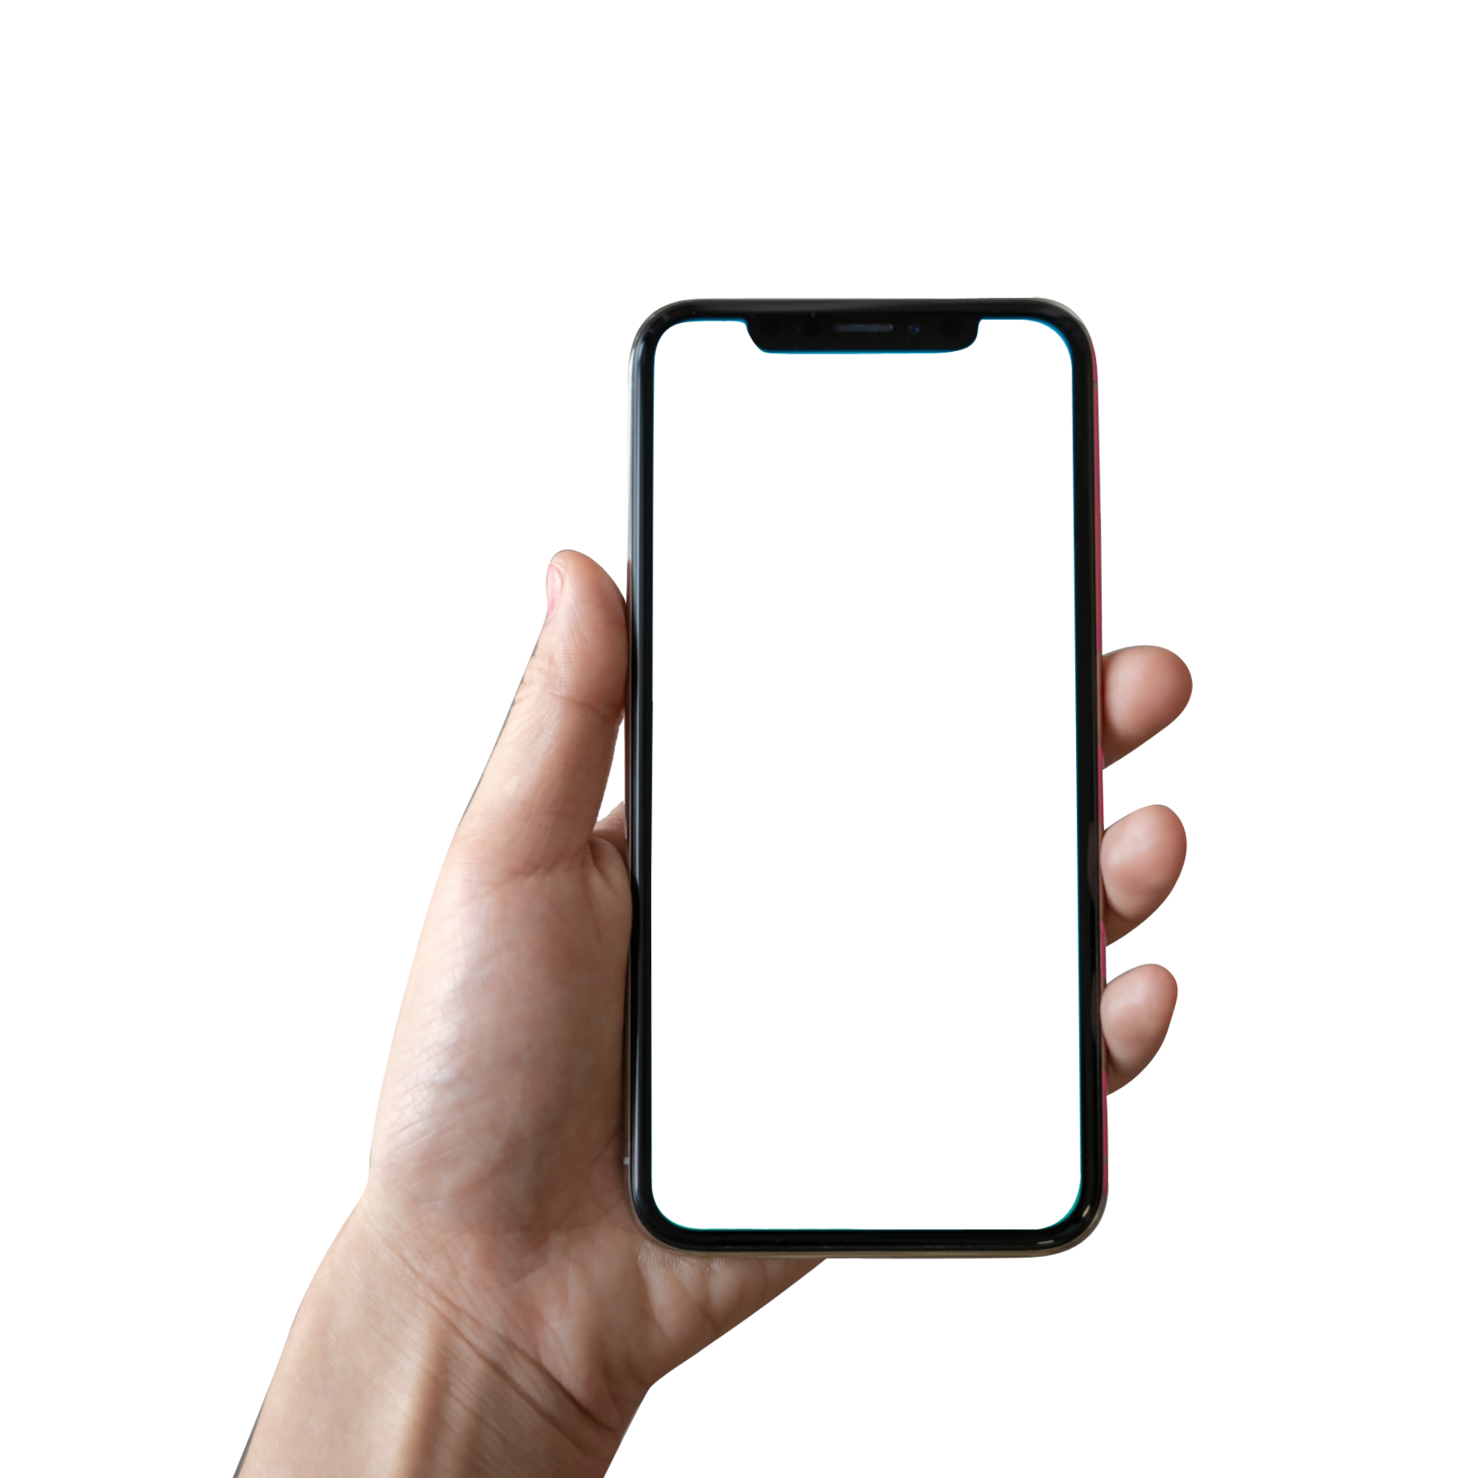



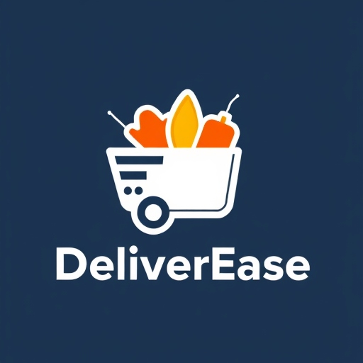
DeliverEase Every Meal, One App Away!
Product Canvas

Slide 2

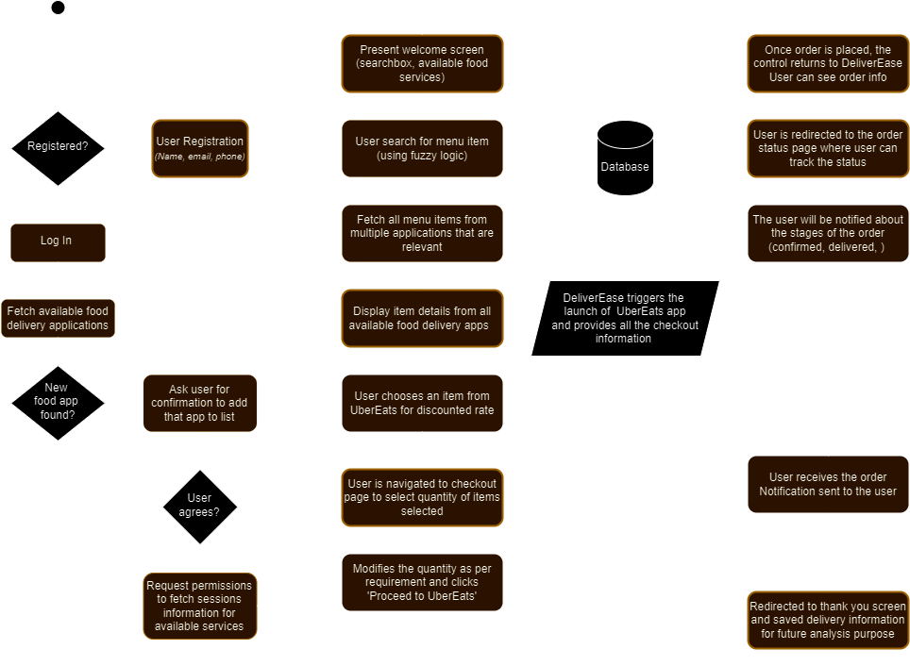



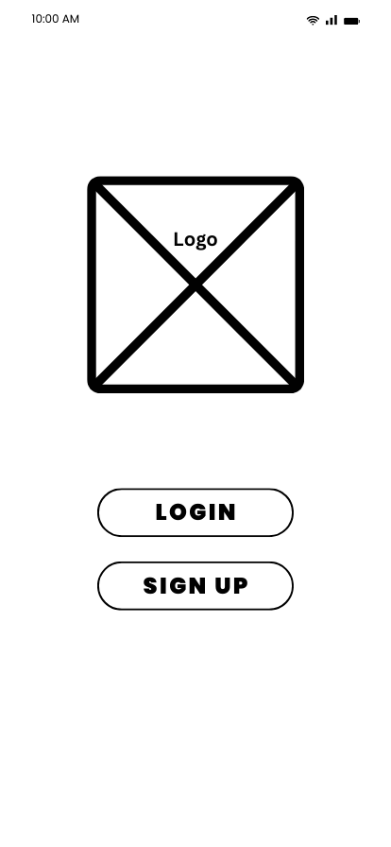

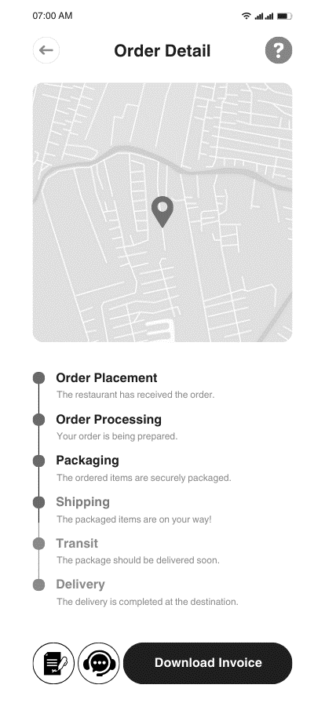
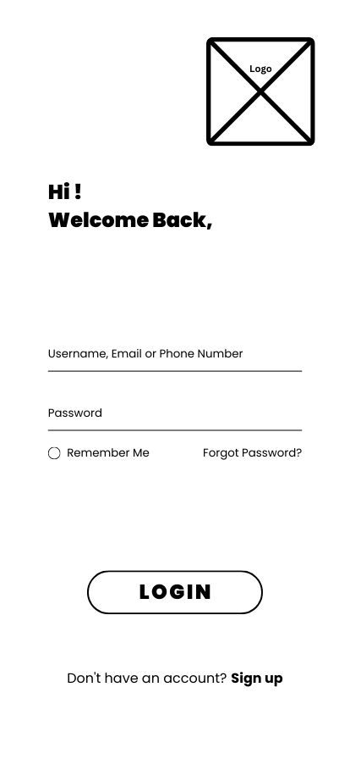
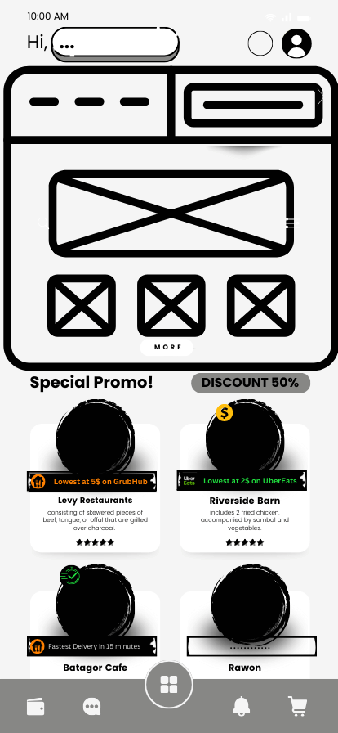
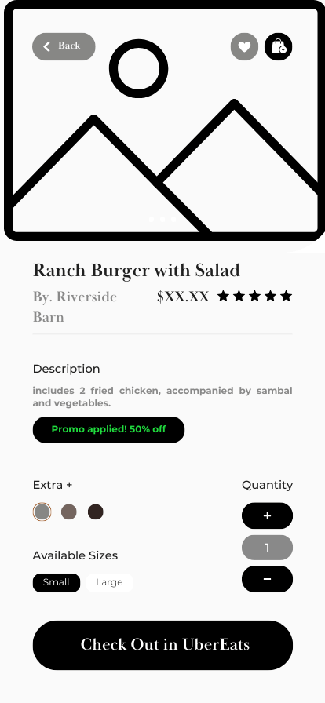
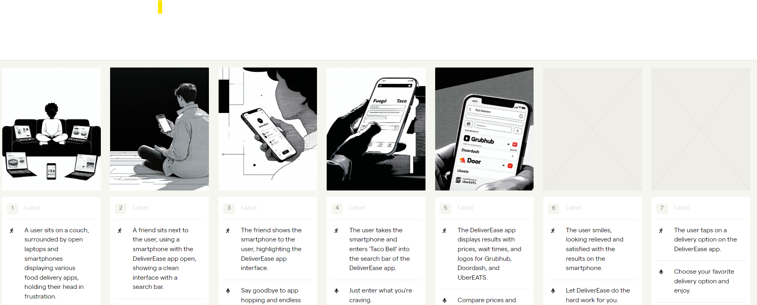
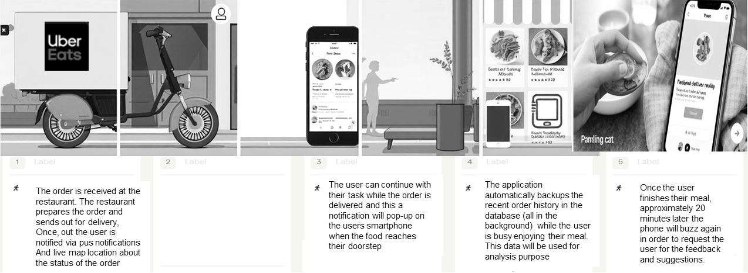
DeliverEase
Vison:
DeliverEase aims to be a quick, hassle free, one-stop solution for consumers to compare real-time food delivery service pricing, wait times and personalized promotions offered by multiple food delivery services such as GrubHub, UberEATS, etc. on the go.
User Personas
Target users from varied age group, locality, and financial backgrounds along with their needs from the new application
Workflow
AGE:
25
LOCALITY:
Urban City
ROLE:
Principal Software Engineer
INCOME:
$85,000 per year
NEEDS:
Fast comparison of delivery times
Intuitive app that remembers past orders for quick re-ordering
AGE:
21
LOCALITY:
Suburban Town
ROLE:
College student
INCOME:
$10,000 per year (prat-time job)
NEEDS:
Cheapest delivery options easily
An app that is within budget
Has no random hidden charges
Metropolitan City
AGE:
24
LOCALITY:
ROLE:
Human Resource Professional
INCOME:
$65,000 per year
NEEDS:
Quickly view multiple food options
Delivery times to minimum
Application must support promo codes
Wireframes
Storyboard

Slide 3
Product Name, Vision and Goal
DeliverEase for Smartphone
Vision: DeliverEase aims to be a quick, hassle free, one-stop solution for consumers to compare real-time food delivery service pricing, wait times and personalized promotions offered by multiple food delivery services such as GrubHub, UberEATS, etc. on the go. With a vision to capture more than 90% of the market share in 2025.
Goal: The main purpose of the application is to save user time and minimize the hassle of navigating through several applications to find the best personalized deals. DeliverEase will be able to cater different segments of users and provide the quickest means to order their daily meals with minimal system interaction and user friendly user interface all while protecting users privacy and security.

Slide 4
Product Success Metrics
Users activity (weekly or monthly)
Reach 2000 daily active users to collaborate with companies for advertisements
User retention rate greater than 55% along with a monthly 20% new users added monthly
Conversion rate (free to paid)
Convert 10% of users quarterly from free ad-based version to paid add-free version
Monetize anonymized user data by collaborating with agencies that want it for research
Generate quality metrics for analysis
Application maintains record of past orders and generates weekly, monthly, quarterly report
Generate a eagle eye view of the application performance showing sales data for admin
Smart recommendation system
By recording order history, location and time app suggests for possible meal choices with best deals through in-app notifications to the users
Location based alerts for best meal items from around 5 miles radius
Notes:
Ability for a user to create an account and login
Ability for a user to search, compare, and add food items to cart from DeliverEaes app (without need of navigating to other app)
Reach 2000 daily active users to collaborate with advertising companies
Admin receives daily app usage statistic reports
App allows for searching with fuzzy logic (restaurant, item, type, veg/non-veg, vegan, etc…)
The app maintains a record of past orders to help user re-order in one click
The app provides order history and information about sales (who, when, where, etc…)
The app also intelligently suggests meals based on location, time, and past orders.

Slide 5
User Personas
James
Devi
Age: 25’
Tech-savvy, working professional Principal Software Engineer
Age: 24’
Works long hours, mostly orders online Human Resource Professional
TaAra
Age: 21’
Vegan, budget conscious, gymnast College student
Notes:
James: Age: 25’ Tech-savvy, working professional Principal Software Engineer
Taara: Age: 21’ Vegan, budget conscious, gymnast College student
Devi: Age: 24’ Works long hours, mostly orders online Human Resource Professional
Rahul: Age 40’ Single, cooks poorly, day job with no fixed location, Carpenter

Slide 6


James J.
ABOUT
James, a 25-year-old software engineer working in a fast-paced urban environment. He has been living away from his home ever since his early 20’s. With his busy schedule and frequent long hours, he relies on food delivery services to save time on meal prep and enjoy the convenience of having food brought directly to his door. James orders food delivery several times a week and values efficiency, reliability, and an intuitive ordering process. He’s tech-savvy but doesn’t want to spend extra time navigating between multiple apps to compare prices and delivery times. He appreciates a streamlined experience that lets him quickly find what he wants, select the best option, and get back to his day without disruptions.
James is usually tied to his desk major time of the day and only takes occasional breaks. These breaks are very short and he only gets a small window where he can use his cell-phone prior to the breaks. This is why James is frustrated about having to use 4-5 different food delivery apps every time he wants to have a meal.
AGE:
25
ROLE:
Principal Software Engineer
NEEDS
A quick way to compare delivery times and prices across services
An intuitive, no-fuss app that remembers her preferences for faster reordering
Reliable information about the delivery times for his orders
The app should be secure and not store sensitive information from his wallet
Needs a clutter free UI with a easy to navigate ordering mechanism
Does not want annoying advertisements in the application
LOCALITY:
Urban City
Works full-time daily, tech-savvy, introvert, enjoys eating alone
KEY METRICS
Socioeconomic Position
PAIN POINTS
Strict daily schedule constraints
Often short lunch-break and can’t waste time navigating between apps
No single means to search for food items across multiple food delivery applications on the go
Current applications have cluttered UI and unwanted pop-ups that waste time
Difficult to order in 2-3 clicks, no re-order last meal option available in all apps
Technical Literacy
Schedule constraints
Scale of expense

Slide 7
Taara S.
ABOUT
Taara is 21, currently a college student in her junior year. She is actively juggling classes, study sessions, and a part-time job. Living off-campus with a few roommates, she often turns to food delivery for quick meals between her packed schedule. When she’s not studying or hanging out with friends, Taara enjoys exploring local food options and trying new places. She prefers apps that make life easier without too much complicated workflows. For her, food delivery is about convenience, cost-saving and flexibility, fitting seamlessly into his busy college life. The cost aspect is one of the most important as she needs to manage her finances smartly while also saving as much as possible. Since she is working part-time jobs that are not as high paying, she needs to actively manage her budget and make sure that she can save as much as possible. None the less, she is passionate about trying variety of food items and wants to explore varied variety of food daily. She is also vegan that makes it frustrating for her to set the preference every time in the food delivery apps she uses daily.
AGE:
21
ROLE:
Junior College Student
NEEDS
Easy comparison of prices and finding the best deals on multiple apps
A free version of the app with ads, but also open to pay a small fee for an ad-free version if affordable
Push notifications on the phone when discounts or student-specific promotions are available
She wants the app to remember her preference (vegan) friendly options only
She absolutely needs a intuitive and clean UI to compare quickly on the go
LOCALITY:
Urban City
Works part-time jobs, vegan, budget conscious, eats healthy
KEY METRICS
Socioeconomic Position
PAIN POINTS
Cannot find the cheapest delivery options quickly in one place
Different platforms have different promo code options and cannot check one by one for every platform
Many applications have hidden fees to wards the last stage of placing orders
Premium plans of delivery are on the higher end
Cannot find nearby vegan restaurants easily
Technical Literacy
Schedule constraints
Scale of expense

Slide 8
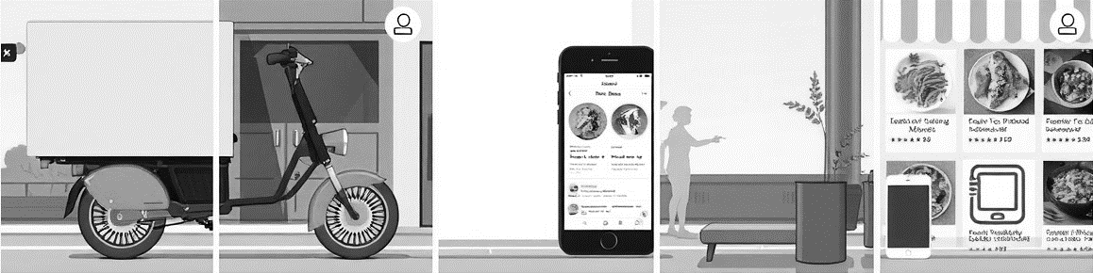
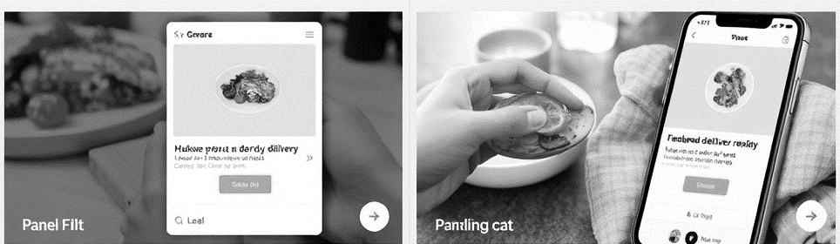

Storyboard
The order is received at the restaurant. The restaurant prepares the order and sends out for delivery,
Once, out the user is notified via pus notifications
And live map location about the status of the order
The user can continue with their task while the order is delivered and this a notification will pop-up on the users smartphone when the food reaches their doorstep
The application automatically backups the recent order history in the database (all in the background) while the user is busy enjoying their meal.
This data will be used for analysis purpose
Once the user finishes their meal, approximately 20 minutes later the phone will buzz again in order to request the user for the feedback and suggestions.

Slide 9
Workflow
Notes:
Open app > Register > Login > Fetch all delivery apps > Present welcome screen > Fetch menu items based on search > show all the prices and discounts based on user profile > Navigate to checkout > Launch selected application > Place order > Return to DeliverEase > Track order status > Redirect to thank you screen and feedback

Slide 10
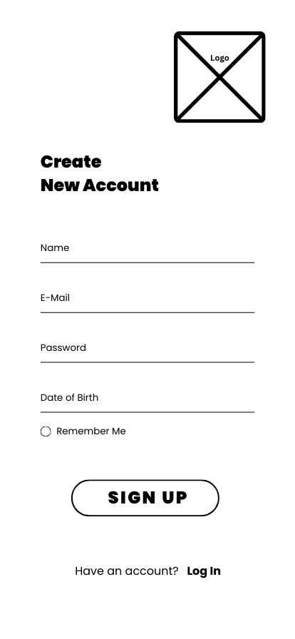
Wireframes
The initial landing page for the app, where it allows existing users to navigate to login page and new users to the registration page
The login page verifies if the user exists in the system and then allows them to enter the application
The Registration page allows new users register and verifies their information. Once verified they are taken to the login page
The menu selection page allows user to add one or more menu item to the bag and checkout the order from users own application
by switching from the current
The home screen allows users to search for a food item and then displays cheapest/fastest options for them to checkout
Once ordered, the application then allows user to track their order with real time updates till the order is delivered to the user
Notes:
Frame 1: Landing Screen
Frame 2: Registration Page
Frame 3: Login Page
Frame 4: Home Page
Frame 5: Checkout to External App Page
Frame 6: Order Tracking Page

Slide 11
Taara S.
ABOUT
Taara is 21, currently a college student in her junior year. She is actively juggling classes, study sessions, and a part-time job. Living off-campus with a few roommates, she often turns to food delivery for quick meals between her packed schedule. When she’s not studying or hanging out with friends, Taara enjoys exploring local food options and trying new places. She prefers apps that make life easier without too much complicated workflows. For her, food delivery is about convenience, cost-saving and flexibility, fitting seamlessly into his busy college life. The cost aspect is one of the most important as she needs to manage her finances smartly while also saving as much as possible. Since she is working part-time jobs that are not as high paying, she needs to actively manage her budget and make sure that she can save as much as possible. None the less, she is passionate about trying variety of food items and wants to explore varied variety of food daily. She is also vegan that makes it frustrating for her to set the preference every time in the food delivery apps she uses daily.
AGE:
21
ROLE:
Junior College Student
NEEDS
Easy comparison of prices and finding the best deals
A free version of the app with ads, but also open to pay a small fee for an ad-free version if affordable
Push notifications on the phone when discounts or student-specific promotions are available
She wants the app to remember her preference (vegan) friendly options only
She absolutely needs a intuitive and clean UI to compare quickly on the go
LOCALITY:
Urban City
Works part-time jobs, vegan, budget conscious, eats healthy
KEY METRICS
Socioeconomic Position
PAIN POINTS
Cannot find the cheapest delivery options quickly in one place
Different platforms have different promo code options and cannot check one by one for every platform
Many applications have hidden fees to wards the last stage of placing orders
Premium plans of delivery are on the higher end
Cannot find nearby vegan restaurants easily
Technical Literacy
Schedule constraints
Scale of expense
Notes:
Mockup (optional)

Slide 12
Epic
Epic 1: Effortless Food Delivery Comparison and Ordering with DeliverEase
Goal : Provide the users with a streamlined platform for comparing food delivery options, placing orders seamlessly, and saving time and money.
Feature 1 : Design and create the Registration page to get new users onboard and verify them via email / SMS verification.
Feature 2 : Unified Fuzzy search across multiple platforms, restaurants, food items and cuisines. Cluster all the results into a single result set from UberEATS, Doordash, etc.
Feature 3 : Real-time and user friendly comparison options of prices, delivery times and possible discounts. Sorting functionality based on user preference like price, rating, etc.
Feature 3 : Track status of orders from confirmation to delivery. Implement the push notification capabilities in the application for updates and timely alerts.
Feature 4 : Highlight key discounts that different platforms offer and automatically apply them if they are applicable.
Feature 5 : Seamless integration with external apps so that DeliverEase wont be syncing any sensitive card information or any other payment related data.
Feature 6 : Ad-Free support with subscription for more quicker and streamlined experience. In-app support to report any issues of need to contact customer support.
Feature 7 : Multi device synchronization for even more flexible user experience.
Notes:
epic

Slide 13
Taara S.
ABOUT
Taara is 21, currently a college student in her junior year. She is actively juggling classes, study sessions, and a part-time job. Living off-campus with a few roommates, she often turns to food delivery for quick meals between her packed schedule. When she’s not studying or hanging out with friends, Taara enjoys exploring local food options and trying new places. She prefers apps that make life easier without too much complicated workflows. For her, food delivery is about convenience, cost-saving and flexibility, fitting seamlessly into his busy college life. The cost aspect is one of the most important as she needs to manage her finances smartly while also saving as much as possible. Since she is working part-time jobs that are not as high paying, she needs to actively manage her budget and make sure that she can save as much as possible. None the less, she is passionate about trying variety of food items and wants to explore varied variety of food daily. She is also vegan that makes it frustrating for her to set the preference every time in the food delivery apps she uses daily.
AGE:
21
ROLE:
Junior College Student
NEEDS
Easy comparison of prices and finding the best deals
A free version of the app with ads, but also open to pay a small fee for an ad-free version if affordable
Push notifications on the phone when discounts or student-specific promotions are available
She wants the app to remember her preference (vegan) friendly options only
She absolutely needs a intuitive and clean UI to compare quickly on the go
LOCALITY:
Urban City
Works part-time jobs, vegan, budget conscious, eats healthy
KEY METRICS
Socioeconomic Position
PAIN POINTS
Cannot find the cheapest delivery options quickly in one place
Different platforms have different promo code options and cannot check one by one for every platform
Many applications have hidden fees to wards the last stage of placing orders
Premium plans of delivery are on the higher end
Cannot find nearby vegan restaurants easily
Technical Literacy
Schedule constraints
Scale of expense
Notes:
User story

